Slide 1
Spatial Data Analysis
Unit IV
TYBSC IT SEM VI
PROF. ARTI GAVAS
ANNA LEELA COLLEGE OF COMMERCE AND ECONOMICS,
SHOBHA JAYARAM SHETTY COLLGE FOR BMS, KURLA

Slide 2
Spatial data analysis
Analytical capabilities of a GIS use spatial and non-spatial (attribute) data to answer questions about real-world
It is the spatial analysis functions that distinguishes GIS from other information systems.
When use GIS to address real-world problems, you'll come up against the question that which analysis function you want to use and to solve the problems.
This include:
  Spatial Data Functions (Format Transformations, Geometric Transformations Projection Transformations etc. )
  Attribute Data Functions (Retrieval, Classification, Verification etc.)
  Integrated Analysis (Overlay, Neighborhood Function, Topographic Functions, Interpolation etc.)

Slide 3
Classification of analytical GIS capabilities
Classification, retrieval, and measurement functions
Overlay functions
Neighbourhood functions
Connectivity functions

Slide 4
Classification, retrieval, and measurement functions
All functions in this category are performed on a single (vector or raster) data layer, using the associated attribute data
Classification allows the assignment of features to a class on the basis of attribute values or attribute ranges
  Classification of different crops like potato and rice
Retrieval functions allow the selective search of data
  Retrieval all agricultural fields where potato is grown
Generalization is a function that joins different classes of objects with common characteristics to a higher level (generalized) class
  Generalization potato and rice fields as food produce fields
Measurement functions allow the calculation of distances, lengths, or areas.

Slide 5
Overlay functions
Allow the combination of two (or more) spatial data layers comparing them position by position, and treating areas of overlap—and of non-overlap—in distinct ways
Intersection
  The potato fields on black soils
Union
  The fields where potato or rice is the crop
Difference
  The potato fields not on black soils
Complement
  The fields that do not have potato as crop

Slide 6
Neighbourhood functions
Evaluates the characteristics of an area surrounding a feature’s location; scans the neighbourhood of the given feature and performs a computation on it
Search functions
  Allow the retrieval of features that fall within a given search window. This window may be a rectangle, circle, or polygon
Buffer zone generation
  Determines a spatial envelope (buffer) around given feature
Interpolation functions
  Predict unknown values using the known values at nearby locations
Topographic functions
  Determine characteristics of an area by looking at the immediate neighbourhood
  E.g. Slope calculation

Slide 7
Connectivity functions
Works on the basis of networks; represent spatial linkages between features
Contiguity functions
  contiguous area of forest of certain size and shape in a satellite image
Network analytic functions
  Road network, public transport routes, high voltage lines or other forms of transportation infrastructure
Visibility functions
  points visible from a given location (Viewshade mapping)

Slide 8

(Classification, retrieval, and measurement)
Measurement
Geometric measurement on spatial features includes counting, distance and area size computations
Measurements on vector data
The primitives of vector data sets are point, (poly)line and polygon.
Related geometric measurements are location, length, distance and area size.
For measuring distance between two features
If one or both of the features are not a point, minimal distance between a location occupied by the first and a location occupied by the second feature is computed

Slide 9
(Classification, retrieval, and measurement)
Measurement
Measurements on raster data
Location is derived from the raster’s anchor point and the position of the cell in the raster
The area size is calculated as the number of cells multiplied by the cell area
The distance between two raster cells is the standard distance function applied to the locations of their respective mid-points

Slide 10
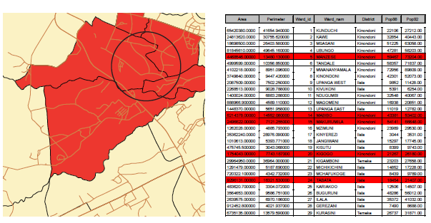
(Classification, retrieval, and measurement)
Spatial selection queries
Interactive spatial selection
Selection condition -> spatial object -> spatial data layer -> select features
Spatial data stored in a geo database is associated with its attribute data through a key/foreign key link. Selections of features lead to selections on the records
Selection condition is defined by drawing spatial objects on the screen display, after having indicated the spatial data layer from which to select features
Here selection object is circle.

Slide 11
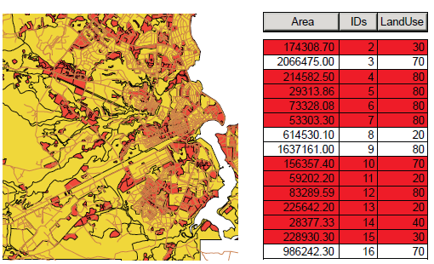
(Classification, retrieval, and measurement)
Spatial selection queries
Spatial selection by attribute conditions
To select features by using selection conditions on feature attributes. These conditions are formulated in SQL if the attribute data reside in a geo-database.
Spatial selection using the attribute condition Area < 400000

Slide 12
(Classification, retrieval, and measurement)
Spatial selection queries
Combining attribute conditions
Atomic conditions use a predicate symbols, < (less than), = (equals), <= (less than or equal), > (greater than), >= (greater than or equal) and <> (does not equal). 400000 and 80 are expressions. Area and LandUSe are attribute names.
E.g. Area < 400000, and LandUse = 80
Composite conditions make use of AND, OR, NOT and the bracket pair ( ).
E.g. Area < 400000 AND LandUse = 80; Area < 400000 OR LandUse = 80, NOT (LandUse = 80), (Area < 30000 AND LandUse = 70) OR (Area < 400000 AND LandUse = 80)

Slide 13
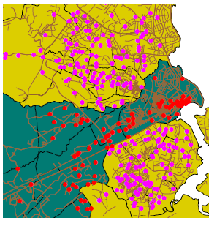
(Classification, retrieval, and measurement)
Spatial selection queries
Spatial selection using topological relationship
1. Selecting features that are inside selection objects: containment relationship
In dark green, some District as the selection objects. In red, all medical clinics located inside these areas, and thus inside the district.

Slide 14
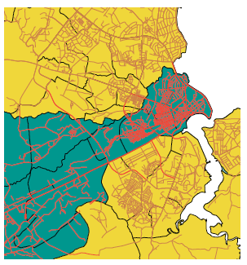
(Classification, retrieval, and measurement)
Spatial selection queries
2. Selecting features that intersect
In dark green some District as the selection objects , and all roads in the district are selected (in red).

Slide 15
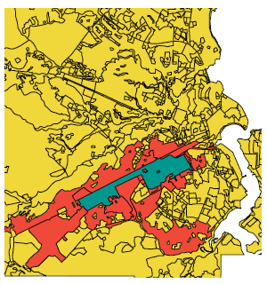
(Classification, retrieval, and measurement)
Spatial selection queries
3. Selecting features adjacent to selection objects: features that share boundaries
In dark green some town, in red industrial area near town

Slide 16
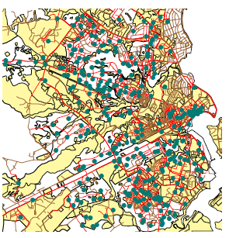
(Classification, retrieval, and measurement)
Spatial selection queries
4. Selecting features based on their distance
In red, roads that are within 200 metres of a medical clinic shown in dark green

Slide 17
Classification
Classification is a technique of purposefully removing detail from an input data set to reveal important patterns of spatial distribution.
User-controlled classification: a user selects the attributes that will be used as the classification parameters and defines the classification method
Automatic classification: a user only specifies the number of classes in the output data set and the system automatically determines the class break points

Slide 18
Classification
Equal interval technique: The minimum and maximum values Vmin and Vmax of the classification parameter are determined and the interval size for each category is calculated as
Vmax - Vmin / n
where n is the number of classes chosen by the user
e.g. if you specify three classes for a field whose values range from 0 to 300, the application will create three classes with ranges of 0–100, 101–200, and 201–300.

Slide 19
Classification
Quantile or Equal frequency technique:
Each class contains an equal number of features. Quantile assigns the same number of data values to each class. There are no empty classes or classes with too few or too many values.

Slide 20
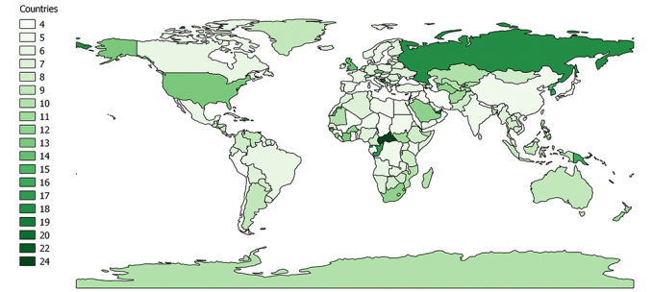
Count the number of letters in country names

Slide 21
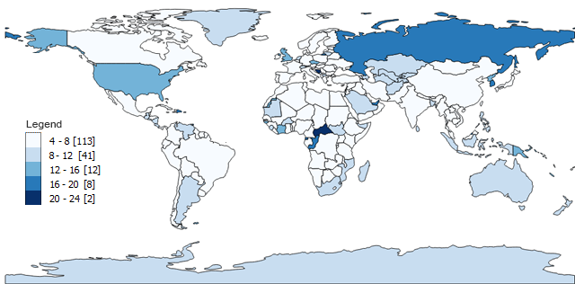
Equal interval:
Class 1: 4 – 8 (113 countries have four, five, six, seven or eight letters)
Class 2: 8 – 12 (41)
Class 3: 12 – 16 (12)
Class 4: 16 – 20 (8)
Class 5: 20 – 24 (2)
We generated 5 classes but the number of classes is entirely up to you.
Max- min = 24 – 4 = 20
Then, it divides 20 by 5 and you get an interval (20/5=4).

Slide 22
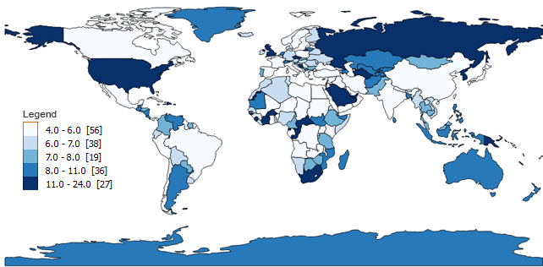
Quantile or Equal Frequency:
Class 1: 4 – 6 (56 countries have 4, 5 or 6-letter names)
Class 2: 6 – 7 (38)
Class 3: 7 – 8 (19)
Class 4: 9 – 11 (36)
Class 5: 12 – 24 (27)
It takes total of number of features (176 countries in our case).
Then, it divides the total by the number of classes to get the average (176/5=35.2).
Finally, quantile maps counts the quantity in each group and arranges them as close to the average as possible.

Slide 23
Overlay functions
Technique of combining two spatial data layers and producing a third from them

Slide 24
Flow computation
Flow computations are determined when a phenomenon does not spread in all directions, but moves or ‘flows’ along a given, least-cost path, determined again by local terrain characteristics.
Raster (a) is original elevation raster. For each cell in that raster, the steepest downward slope to a neighbour cell is computed, and its direction is stored in a new raster.
Raster (b) can be called the flow direction raster.
From raster (b), the GIS can compute the accumulated flow count raster, raster (c), a raster that for each cell indicates how many cells have their water flow into the cell.
Cells with a high accumulated flow count represent areas of concentrated flow, and thus may belong to a stream.
Cells with an accumulated flow count of zero are local topographic highs, and can be used to identify ridges.

Slide 25
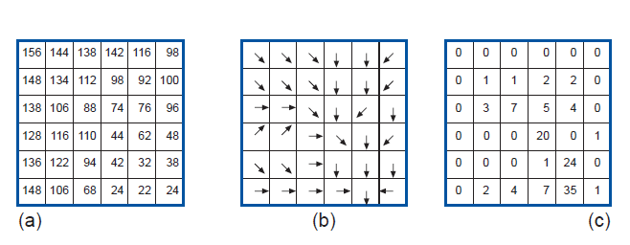

Slide 26
Network analysis
A network is a connected set of lines, representing some geographic phenomenon
Directed networks associate with each line a direction of transportation; undirected networks do not
Planar network can be embedded in a two-dimensional plane
Spatial analysis functions on networks are
  Optimal path finding: least cost-path on a network between a pair of predefined locations
  Network partitioning: assigns network elements to different locations using predefined criteria

Slide 27
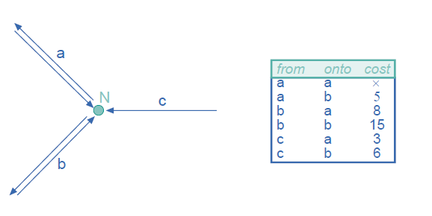
Turning Cost Table

Slide 28
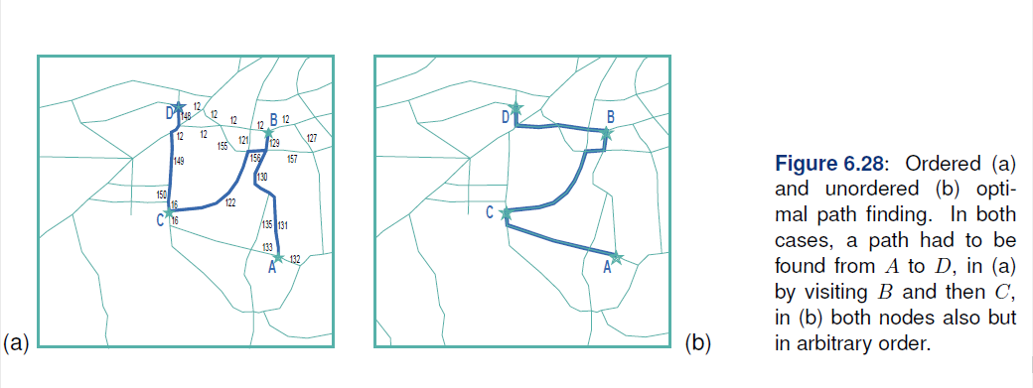
Ordered & Unordered path finding

Slide 29
Network partitioning
Network partitioning is the process of creating zones or territories from a street network, such that each link is assigned to the closest or least cost service location, based on a service value, such as driving distance or time.
For example, you could use network partitioning to divide a city into zones based on the response time from all of the fire stations within that city. Each zone would be comprised of the streets for which its fire station has the fastest response time.

Slide 30
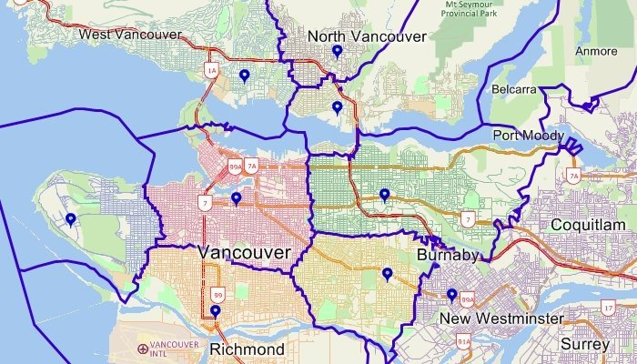
The streets in this map were partitioned into zones based on the driving time to the nearest service point. No matter where you are in any of the zones, the point that is the shortest drive-time away is the one located within that zone.

Slide 31
Network / Location Allocation
Given facilities that provide goods and services and a set of demand points that consume them, the goal of location-allocation is to locate the facilities in a way that supplies the demand points most efficiently. As the name suggests, location-allocation is a twofold problem that simultaneously locates facilities and allocates demand points to the facilities.
Initially, it may appear that all location-allocation analyses solve the same problem, but the best location is not the same for all types of facilities. For instance, the best location for an ERS center is different than the best location for a manufacturing plant.

Slide 32
Network / Location Allocation
Example 1: Locating an ERS center
When someone calls for an ambulance, we trust it will come to their aid almost instantly; the emergency response time depends considerably on the distance between the ambulance and the patient. Typically, the goal for determining the best sites for ERS centers is to make it possible for ambulances to reach the most people within a defined time frame. The specific question may be: Where should three ERS facilities be placed so that the greatest number of people in the community can be reached within four minutes?

Slide 33
Network / Location Allocation
Example 2: Locating a manufacturing plant
Many retail outlets receive their goods from manufacturing plants. Whether producing automobiles, appliances, or packaged food, a manufacturing plant can spend a large percentage of its budget on transportation. Location-allocation can answer the following question: Where should the manufacturing plant be located to minimize overall transportation costs?

Slide 34
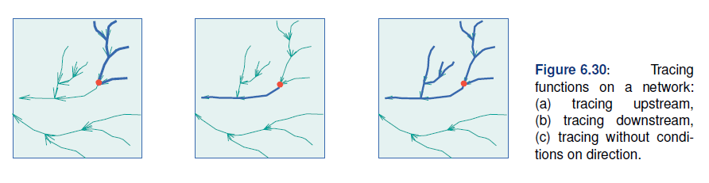
Trace Analysis
The term tracing is used here to describe building a set of network elements according to some procedure.

Slide 35
GIS and It’s Application Models
Mathematical construct for representing geographic objects or surfaces as data
Five characteristics of GIS-based application models:
  The purpose of the model,
  The methodology underlying the model,
  The scale at which the model works,
  Its dimensionality - i.e. whether the model includes spatial, temporal
  Its implementation logic - i.e. the extent to which the model uses existing knowledge about the implementation context.

Slide 36
Characteristics of application models
Purpose of the model
refers to whether the model is descriptive, prescriptive or predictive in nature.
Descriptive models attempt to answer the “what is” - question.
Prescriptive models usually answer the “what should be” question
Predictive models focus upon the “what is likely to be” questions

Slide 37
Characteristics of application models
Methodology
refers to the operational components of the model.
Stochastic models use statistical or probability functions to represent random or semi-random of phenomena.
Deterministic models are based upon a well-defined cause and effect relationship
Rule-based models attempt to model processes by using local (spatial) rules
Agent-based models (ABM) attempt to model movement and development of multiple interacting agents

Slide 38
Characteristics of application models
Scale
refers to whether the components of the model are individual or aggregate in nature.
refers to the ‘level’ at which the model operates.
Individual-based models are based on individual entities, such as the agent-based models such as salary of individual
Aggregate models deal with ‘grouped’ data such as population census data.

Slide 39
Characteristics of application models
Dimensionality
refer to whether a model is static or dynamic,and spatial or aspatial.
Spatial model operate in some geographically defined space.
Aspatial models have no direct spatial reference.
Models can also be static, meaning they do not incorporate a notion of time or change.
In dynamic models, time is an essential parameter

Slide 40
Characteristics of application models
Implementation logic
refers to how the model uses existing theory or knowledge to create new knowledge.
Deductive approaches use knowledge of the overall situation in order to predict outcome conditions.
This includes models that have some kind of formalized set of criteria, often with known weightings for the inputs, and existing algorithms are used to derive outcomes.
Inductive approaches try to generalize, trial and error

Slide 41
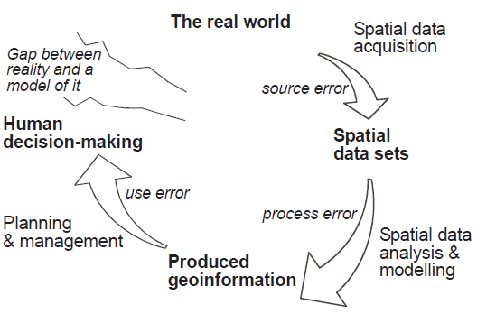
Error propagation in spatial data processing

Slide 42
Thank You!

